Slide 1

DSI9
Capstone
Project
Ideas

Slide 2

Amazon review rating prediction for {cameras}
Notes:
Hubspot - online reviews are as helpful as friends and family during purchase decision.
Higher rankings on the site.
Marketing insight
Predicting the review rating, by review using NLP
https://cdn2.hubspot.net/hubfs/476778/PDFs/OneLocal_-_The_Importance_of_Reviews.pdf?t=1495210977015

Slide 3

Problem
Statement
In a saturated product market that moves fast. How can sellers determine features or products that customers really want?
Notes:
Think of the last review you wrote, maybe it was for a restaurant or an uber
What did you want the business owner or other people to know about your experience? Sentiment, feature
Amazon product review is simply a mirror of the consumer’s thoughts relating to that product. The analysis of product review can actually help you in understanding consumers’ demand and interests.

Slide 4

Potential
Audience
Product developers and marketeers.
Seeking opportunities in the market through unmet needs.
John Doenut
Product Manager

Slide 5

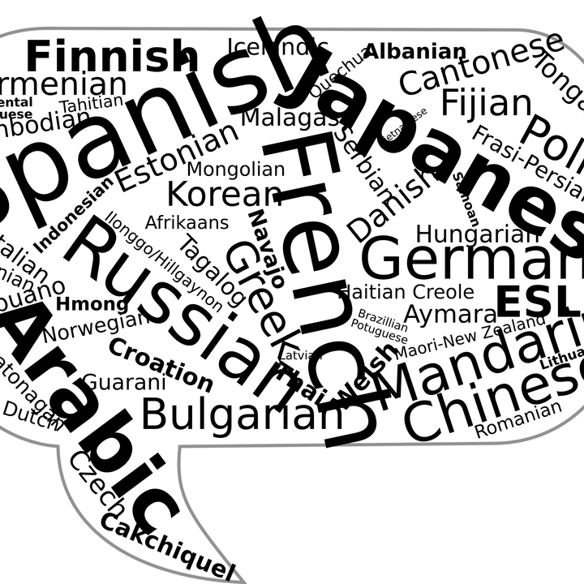

Goals
Collecting, and cleaning reviews
Through dataset and web scraping.
Gain insight into which
features are divisive
in customer opinion.
Natural Language Processing
Determine the sentiment and key words that predict rating
Web scraping and testing my model
Obtaining current review data to test my model.

Slide 6

Success Metrics
Based on different scenarios, using collected data to give a recommendation to potential audiences.
Model that performs above the baseline score on two test sets. One from a train test split, and the second from recent web scraped data.

Slide 7
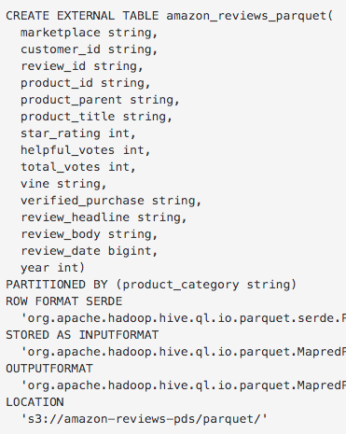

Dataset
SQL Query
https://registry.opendata.aws/amazon-reviews
A collection of reviews written in the Amazon.com marketplace and associated metadata from 1995 until 2015.
(130M+ customer reviews)
SQL Query
Tab Separated .TSV
Web Scraping
https://registry.opendata.aws/amazon-reviews/
Tab Separated .TSV
Alternatively available in Parquet
Web Scraping
Fosduo dolores etoa jam rebum. Steto clita kuasd gubergren, nosotra seao.

Slide 8
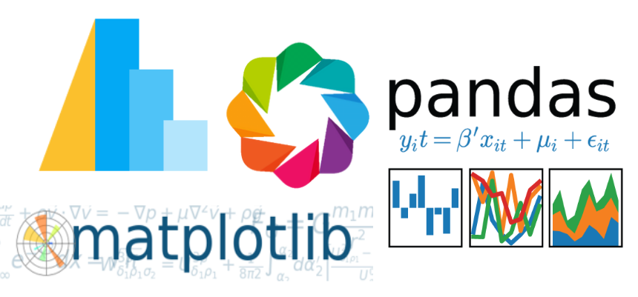
Technology List
Python
This project using Python-3.6 environment
Numpy
The fundamental package for scientific computing with Python
Pandas
Easy-to-use data structures and data analysis tools for Python
Beastiful Soup
Convert web page to xml so that all infomation on that page can be accessed and scraped easily
Selenium
Function as automates browsers in order to scrape infomation held by JavaScript
Seaborn
A Python visualization library provides a high-level interface for drawing attractive statistical graphics.
Sci-kit Learn
Simple and efficient package for data mining and data analysis
spaCy and textacy
Python library for performing a variety of Natural Language Processing (NLP tasks)

Slide 9
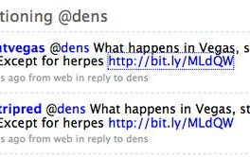

Twitter bot detection classifier
Notes:
Hubspot - online reviews are as helpful as friends and family during purchase decision.
Higher rankings on the site.
Marketing insight
Predicting the review rating, by review using NLP
https://cdn2.hubspot.net/hubfs/476778/PDFs/OneLocal_-_The_Importance_of_Reviews.pdf?t=1495210977015

Slide 10

Problem
Statement
Tweets from bot accounts contribute to trending conversations, talking points, memes, and conspirational claims that get picked up by real people online.
Notes:
Bots can inflate a topic's importance or tarnish reputations by flooding social networks with fake news and by manipulating the currency of Twitter: likes and shares, follows and retweets. Just how that translates into votes is unclear,
“The Turing test aimed to recognize the behavior of a human from that of a computer algorithm. Such challenge is more relevant than ever in today's social media context, where limited attention and technology constrain the expressive power of humans, while incentives abound to develop software agents mimicking humans. These social bots interact, often unnoticed, with real people in social media ecosystems, but their abundance is uncertain. While many bots are benign, one can design harmful bots with the goals of persuading, smearing, or deceiving… “

Slide 11
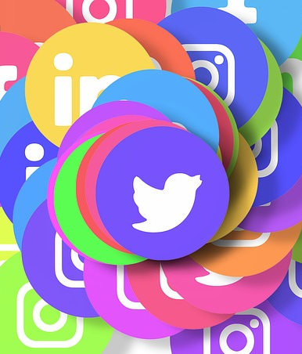
Potential
Audience
Twitter and social networks
Media outlets and political journalists monitoring public discourse online

Slide 12

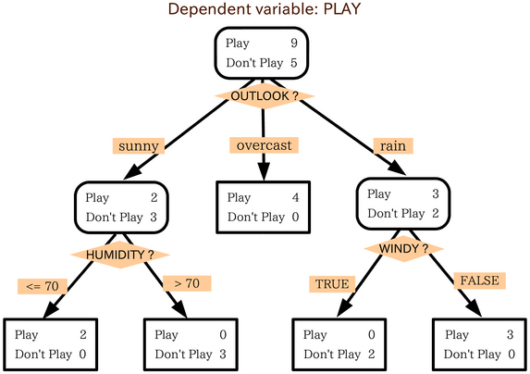

Goals
Collect pre classified bot tweets
Buy a bot network. Find datasets during recent campaigns.
Build a classification model to detect bot tweets.
Potentially calculate the impact on a recent online conversation
NLP and classification models
Determine what makes a bot a bot? Traffic detection?
Testing model on a recent conversation
Brexit

Slide 13
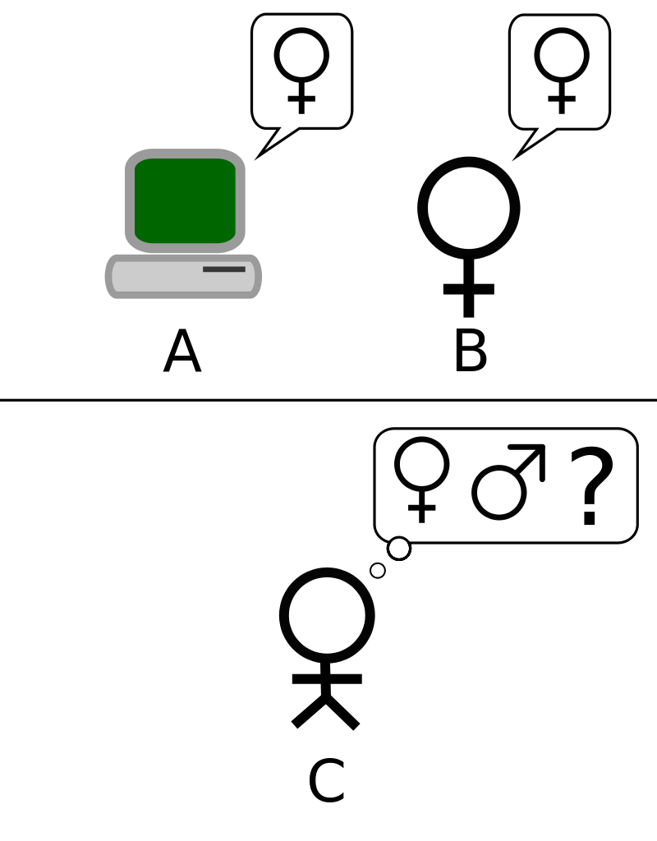
Success Metrics
Accuracy, precision, recall and F1 score on my classification models

Slide 14

Dataset
Columns
id
id_str
screen_name
location
description
url
followers_count
friends_count
listedcount
created_at
favourites_count
verified
statuses_count
lang
status
default_profile
default_profile_image
has_extended_profile
name
bot
NYU Tandon Spring 2017 Machine Learning Competition: Twitter Bot classification
https://www.kaggle.com/c/twitter-bot-classification/data?

Slide 15
Thank you.

